Slide 1
Optimization
Neural Networks & Fuzzy Logic (BITS F312)
Ashish Patel
Lectures during November 21 - 28, 2017

Slide 2
Introduction
Optimization is defined as the method of minimizing or maximizing a function of several variables, i.e. finding those values the variables for which the function takes on the minimum or maximum value.
Point at which the function takes its minimum or maximum value is called a minimizer or maximizer respectively.

Slide 3
Applications of Optimization
Optimization problems arise in almost all fields where numerical information is processed (science, engineering, mathematics, economics, commerce, etc.)
In science, optimization problems arise in data mining, solution of differential and integral equations, etc.
Engineering applications are in design problems, which usually have constraints in the sense that variables can not take arbitrary values.
For example, while designing a bridge, an engineer will be interested in minimizing the cost, while maintaining a certain minimum strength for the structure.

Slide 4
Gradient of a Function
The gradient of a function f(x₁, x₂, …., x_{n}) is given by
Important properties of gradient:
If we move along the gradient direction from any point in n-dimensional space, the function value increases at the fastest rate. Hence the gradient direction i.e. S = ∇f is called the direction of steepest ascent .
If we move against the gradient direction from any point in n-dimensional space, the function value decreases at the fastest rate. Hence the opposite of gradient direction i.e. S = -∇f is called the direction of steepest descent .

Slide 5
Direction of steepest ascent/descent is a local property, not a global one.
Any method that makes use of the gradient vector can be expected to give the minimum point faster than one that does not make use of the gradient vector.
All the descent methods make use of the gradient vector, either directly or indirectly, in finding the search directions.

Slide 6
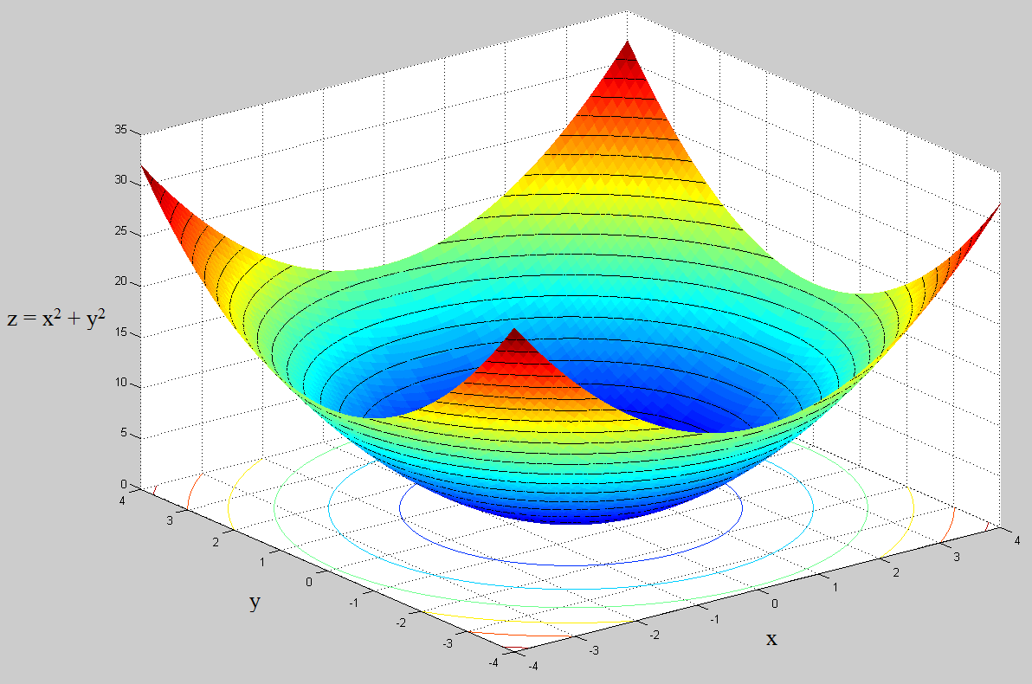
Fig. 1.4 shows that contour plot of a 3-dimensional surface plot.
A contour line of a function of two variables is a curve along which the function has a constant value.
Figure 1.4 Contour lines representation for surface plot

Slide 7
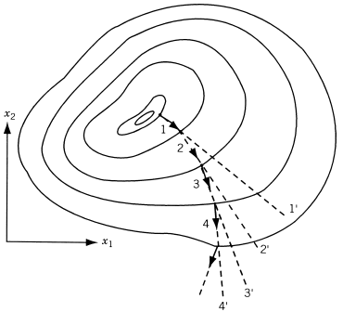
Fig. 1.5 shows steepest ascent directions.
The gradient vectors ∇f evaluated at points 1, 2, 3, and 4 lie along the directions 11′, 22′, 33′, and 44′, respectively.
The function value increases at the fastest rate in the direction 11′ at point 1, but not at point 2. Similarly, the function value increases at the fastest rate in direction 22′ or 33′ at point 2 or 3, but not at point 3 or 4 respectively.
In other words, the direction of steepest ascent generally varies from point to point, and if we make infinitely small moves along the direction of steepest ascent, the path will be a curved line like the curve 1–2–3–4 in Fig. 1.5.
Figure 1.5 Steepest ascent directions

Slide 8
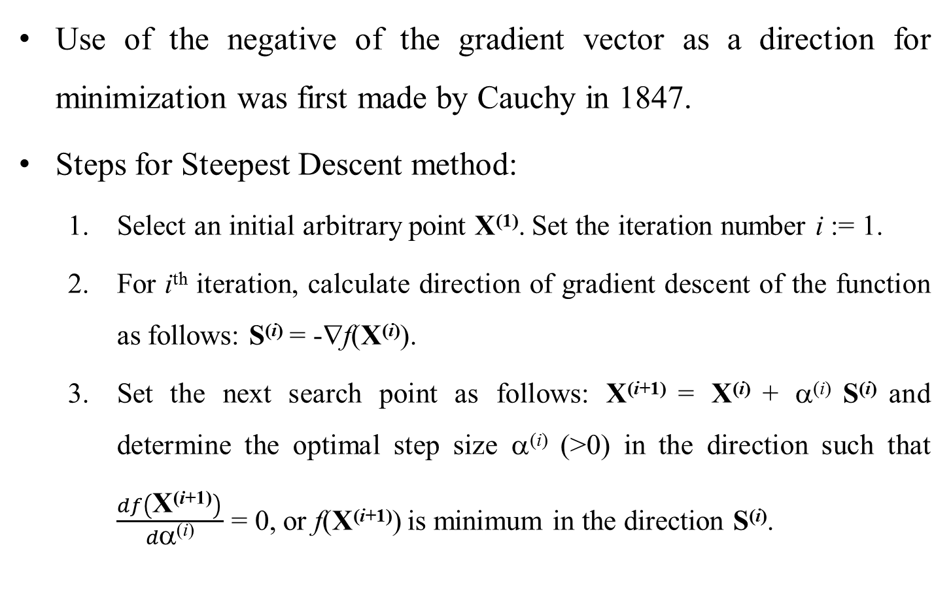
Steepest Descent Method
Use of the negative of the gradient vector as a direction for minimization was first made by Cauchy in 1847.
Steps for Steepest Descent method:
Select an initial arbitrary point X⁽¹⁾. Set the iteration number i := 1.
For i^{th} iteration, calculate direction of gradient descent of the function as follows: S^{(i)} = -∇f(X^{(i)}).
Set the next search point as follows: X^{(i+1)} = X^{(i)} + α^{(i)} S^{(i)} and determine the optimal step size α$\text{(}\text{i}\text{)}$ (>0) in the direction such that $\frac{df\left(\text{X}\text{(}\text{i}\text{+}\text{1)}\right) }{d\text{α}\text{(}\text{i}\text{)}}$ = 0, or f(X^{(i+1)}) is minimum in the direction S^{(i)}.

Slide 9
Test the new point for optimality using one of the following criterion:
When the gradient vector becomes zero i.e. ∇f(X^{(i+1)}) = 0.
When the change in function value in two consecutive iterations is small i.e. |f(X^{(i+1)})-f(X^{(i)})| ≤ ε₁.
When the components of the gradient ∇f are small i.e. |∂f/∂x_{j}| ≤ ε₁ where j = 1, 2, ..., n.
When the change in the design vector in two consecutive iterations is small i.e. |X^{(i+1)}-X^{(i)}| ≤ ε₁.
If X^{(i+1)} is optimum, then stop the process. Otherwise, go to Step 5.
Set the new iteration number i := i + 1 and go to Step 2.
Note: Steps for Steepest Ascent are same as those, except Step 2, for Steepest Descent. Set direction gradient ascent as S^{(i)} = ∇f(X^{(i)}).

Slide 10
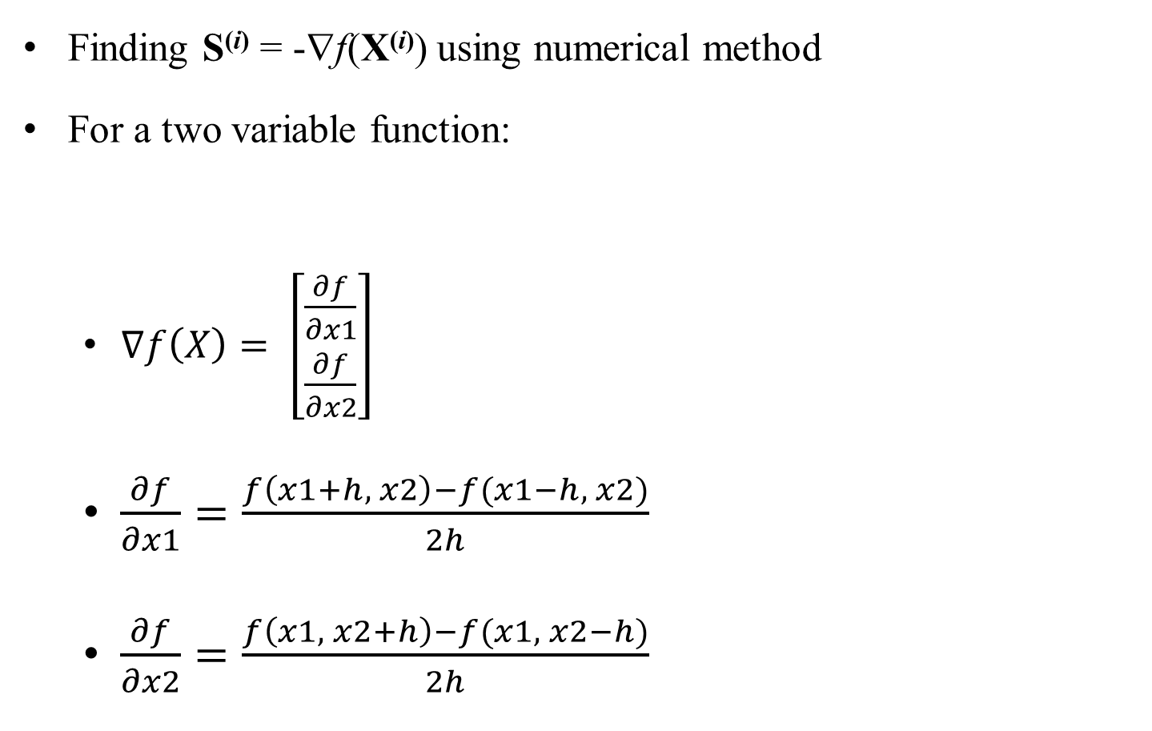
Step 2 of Steepest Descent Method
Finding S^{(i)} = -∇f(X^{(i)}) using numerical method
For a two variable function:
$∇f\left(X\right)= \left[\begin{matrix}\frac{∂f}{∂x1} \\ \frac{∂f}{∂x2}\end{matrix}\right]$
$\frac{∂f}{∂x1}=\frac{f\left(x1+h, x2\right)−f(x1−h, x2)}{2h}$
$\frac{∂f}{∂x2}=\frac{f\left(x1, x2+h\right)−f(x1, x2−h)}{2h}$

Slide 11
Step 3 of Steepest Descent Method
Perform unidirectional search to find optimum α^{(i)} such that f(X^{(i+1)}) or f(X^{(i)} + α^{(i)} S^{(i)}) is minimum
Unidirectional search methods:
Bisection method
Fibonacci Search method
Golden Section Search method
(Fast and less computationally intensive search method)

Slide 12
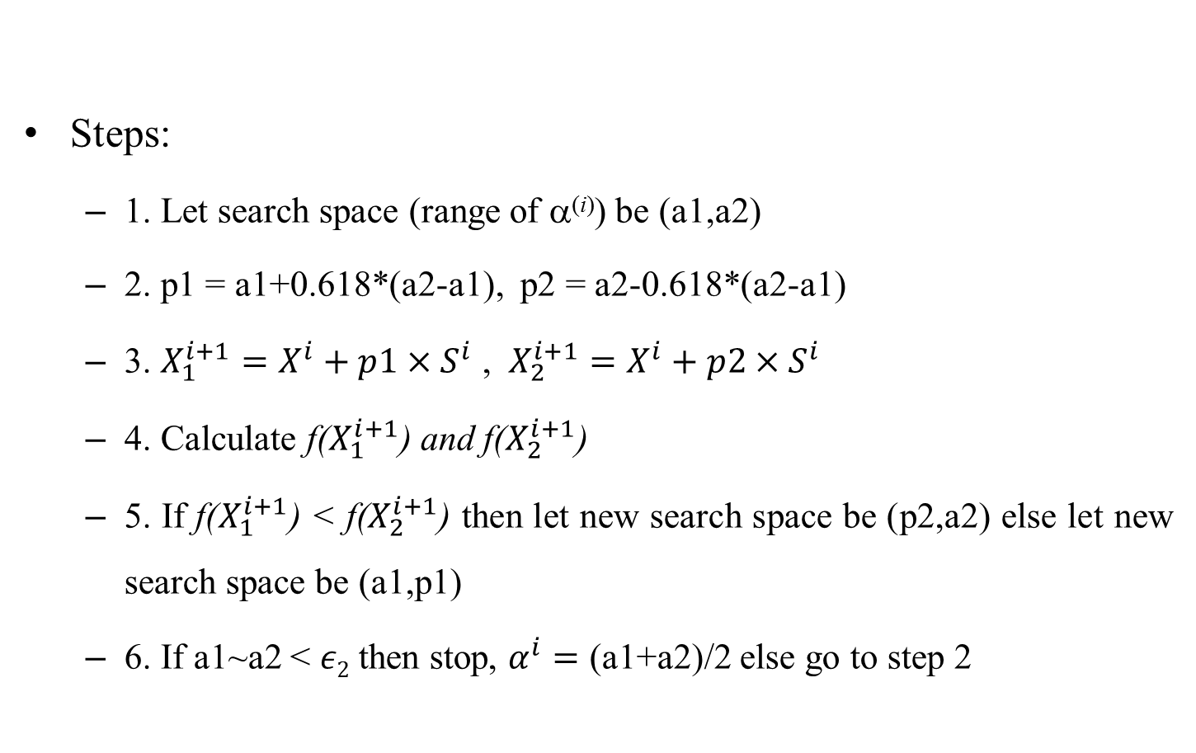
Golden Section Search Method
Steps:
1. Let search space (range of α^{(i)}) be (a1,a2)
2. p1 = a1+0.618*(a2-a1), p2 = a2-0.618*(a2-a1)
3. $X_{1}^{i+1}=X^{i}+p1×S^{i}$ , $X_{2}^{i+1}=X^{i}+p2×S^{i}$
4. Calculate f($X_{1}^{i+1}$) and f($X_{2}^{i+1}$)
5. If f($X_{1}^{i+1}$) < f($X_{2}^{i+1}$) then let new search space be (p2,a2) else let new search space be (a1,p1)
6. If a1~a2 < $ε2$ then stop, $α^{i}=$ (a1+a2)/2 else go to step 2
a1
p2
p1
a2

Slide 13
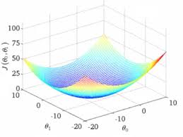
Steepest descent converges to single local minima as shown in Fig. 1.6. Convergence to optimal global point does not depend on initial point but step size (or learning rate as in neural network learning algorithm).
Figure 1.6 Surface with single local minima

Slide 14
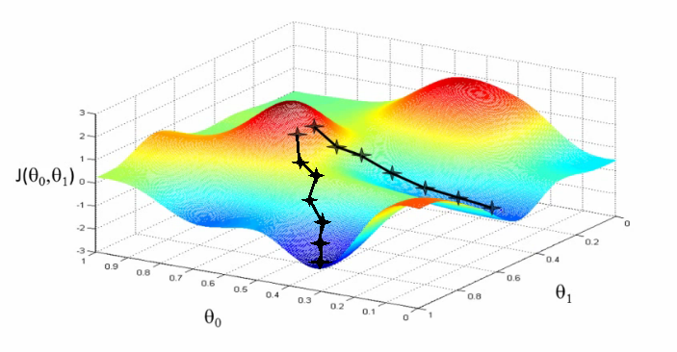
Steepest descent converges to one of local minima as shown in Fig. 1.7. Convergence to local minima depends on initial point as well as step size (or learning rate as in neural network learning algorithm).
Figure 1.7 Surface with multiple local minima

Slide 15
Illustrating Effect of Step Size on Gradient Descent
Objective function: f(x) = x²
Initial point: x = 1
Variable step size: α = 0, 0.1, 0.2, 0.3, 0.4, 0.5, 0.6, 0.7, 0.8, 0.9, 1
Optimal step size: α = 0.5

Slide 16
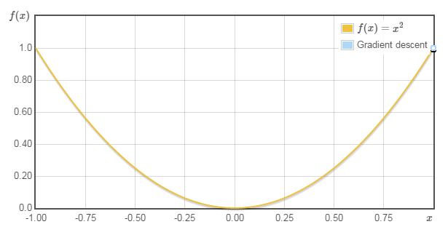
Objective function: f(x) = x²
Initial point: x = 1
Step size: α = 0
Courtesy: http://www.onmyphd.com/?p=gradient.descent&ckattempt=1

Slide 17
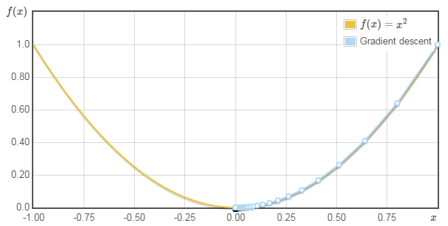
Objective function: f(x) = x²
Initial point: x = 1
Step size: α = 0.1
Courtesy: http://www.onmyphd.com/?p=gradient.descent&ckattempt=1

Slide 18
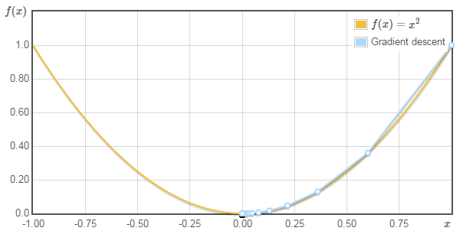
Objective function: f(x) = x²
Initial point: x = 1
Step size: α = 0.2
Courtesy: http://www.onmyphd.com/?p=gradient.descent&ckattempt=1

Slide 19
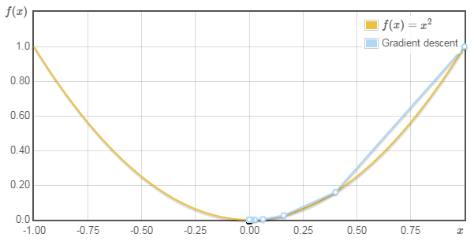
Objective function: f(x) = x²
Initial point: x = 1
Step size: α = 0.3
Courtesy: http://www.onmyphd.com/?p=gradient.descent&ckattempt=1

Slide 20
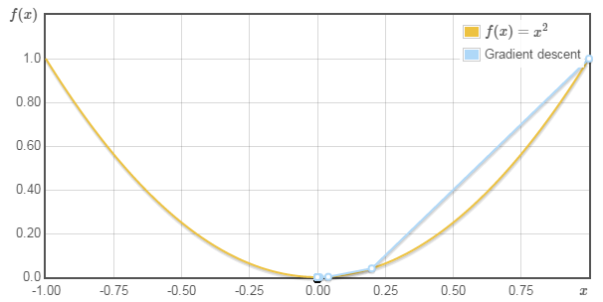
Objective function: f(x) = x²
Initial point: x = 1
Step size: α = 0.4
Courtesy: http://www.onmyphd.com/?p=gradient.descent&ckattempt=1

Slide 21
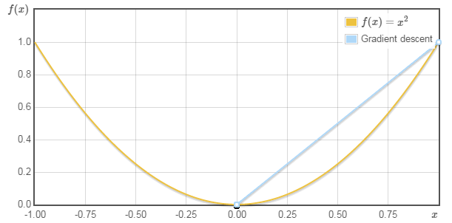
Objective function: f(x) = x²
Initial point: x = 1
Step size: α = 0.5 (optimal)
Courtesy: http://www.onmyphd.com/?p=gradient.descent&ckattempt=1

Slide 22
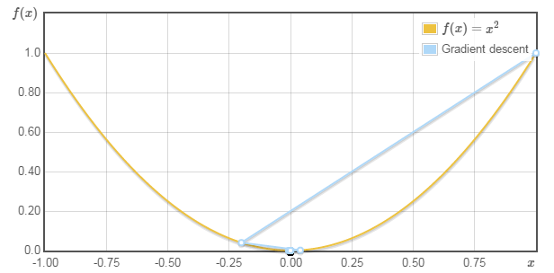
Objective function: f(x) = x²
Initial point: x = 1
Step size: α = 0.6
Courtesy: http://www.onmyphd.com/?p=gradient.descent&ckattempt=1

Slide 23
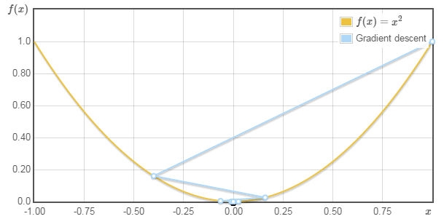
Objective function: f(x) = x²
Initial point: x = 1
Step size: α = 0.7
Courtesy: http://www.onmyphd.com/?p=gradient.descent&ckattempt=1

Slide 24
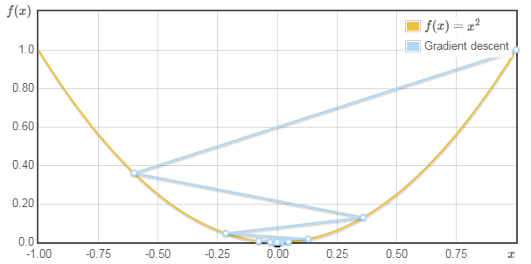
Objective function: f(x) = x²
Initial point: x = 1
Step size: α = 0.8
Courtesy: http://www.onmyphd.com/?p=gradient.descent&ckattempt=1

Slide 25
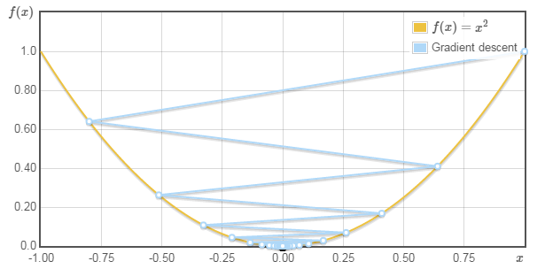
Objective function: f(x) = x²
Initial point: x = 1
Step size: α = 0.9
Courtesy: http://www.onmyphd.com/?p=gradient.descent&ckattempt=1

Slide 26
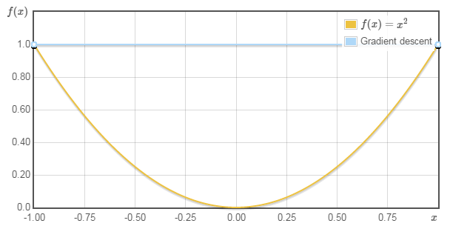
Objective function: f(x) = x²
Initial point: x = 1
Step size: α = 1
Courtesy: http://www.onmyphd.com/?p=gradient.descent&ckattempt=1

Slide 27
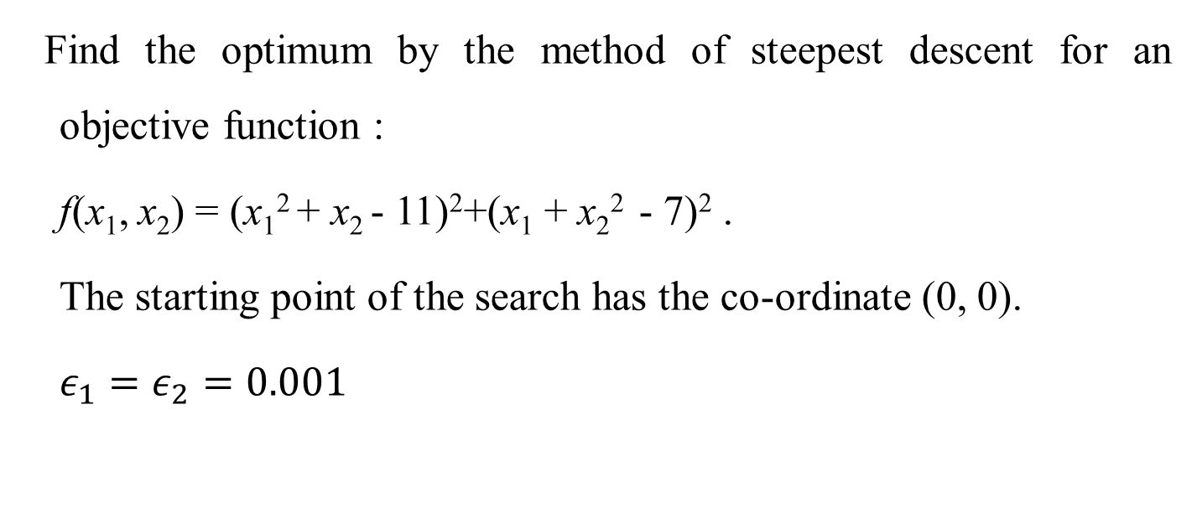
Numerical Example for Steepest Descent Method
Find the optimum by the method of steepest descent for an objective function :
f(x₁, x₂) = (x₁² + x₂ - 11)²+(x₁ + x₂² - 7)² .
The starting point of the search has the co-ordinate (0, 0).
$ε_{1}=ε_{2}=0.001$

Slide 28

Iteration 1
i = 0
$X^{0}= \left[\begin{matrix}0 \\ 0\end{matrix}\right]$
Step 2
Let h = 0.001
$\frac{∂f}{∂x1}=$ -14
$\frac{∂f}{∂x2}=$ -22
$S^{0}= \left[\begin{matrix}14 \\ 22\end{matrix}\right]$

Slide 29
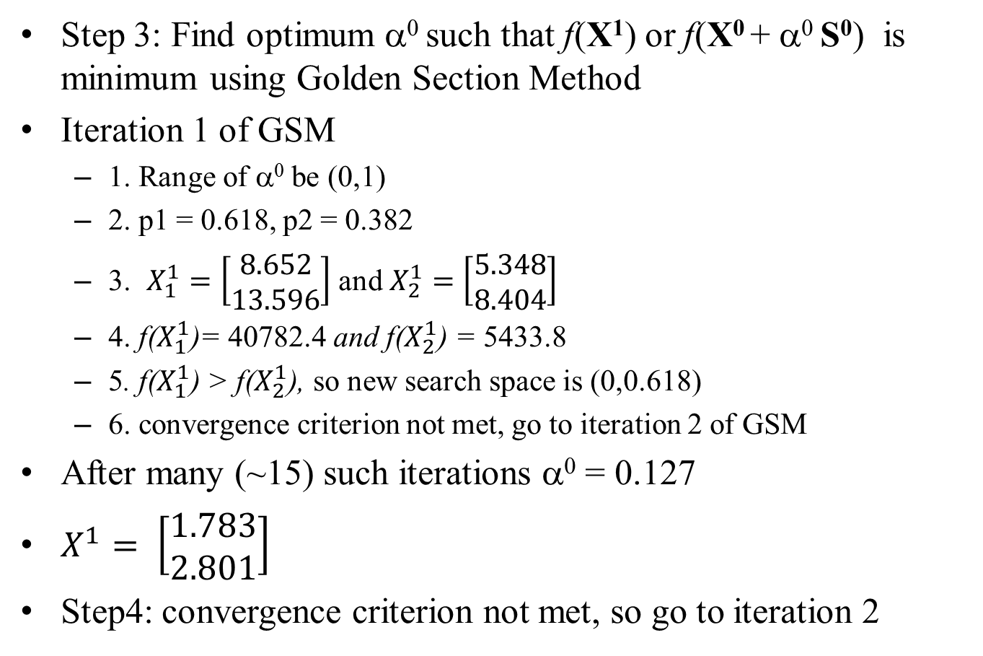
Iteration 1
Step 3: Find optimum α⁰ such that f(X¹) or f(X⁰ + α⁰ S⁰) is minimum using Golden Section Method
Iteration 1 of GSM
1. Range of α⁰ be (0,1)
2. p1 = 0.618, p2 = 0.382
3. $X_{1}^{1}=\left[\begin{matrix}8.652 \\ 13.596\end{matrix}\right]$ and $X_{2}^{1}=\left[\begin{matrix}5.348 \\ 8.404\end{matrix}\right]$
4. f($X_{1}^{1}$)= 40782.4 and f($X_{2}^{1}$) = 5433.8
5. f($X_{1}^{1}$) > f($X_{2}^{1}$), so new search space is (0,0.618)
6. convergence criterion not met, go to iteration 2 of GSM
After many (~15) such iterations α⁰ = 0.127
$X^{1}= \left[\begin{matrix}1.783 \\ 2.801\end{matrix}\right]$
Step4: convergence criterion not met, so go to iteration 2

Slide 30

Iteration 2
i = 1
$X^{1}= \left[\begin{matrix}1.783 \\ 2.801\end{matrix}\right]$
Step 2
Let h = 0.001
$\frac{∂f}{∂x1}=$ -30.452
$\frac{∂f}{∂x2}=$ 19.428
$S^{1}= \left[\begin{matrix}30.452 \\ −19.428\end{matrix}\right]$

Slide 31
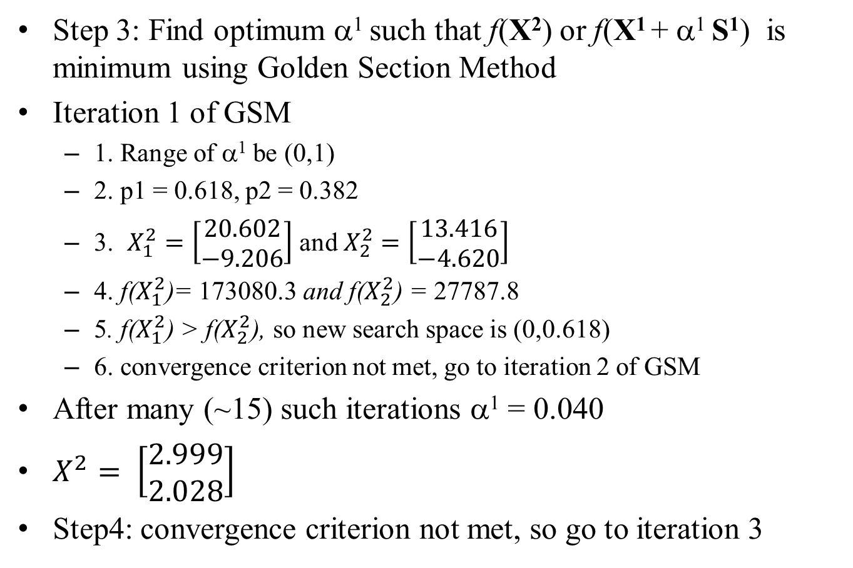
Iteration 2
Step 3: Find optimum α¹ such that f(X²) or f(X¹ + α¹ S¹) is minimum using Golden Section Method
Iteration 1 of GSM
1. Range of α¹ be (0,1)
2. p1 = 0.618, p2 = 0.382
3. $X_{1}^{2}=\left[\begin{matrix}20.602 \\ −9.206\end{matrix}\right]$ and $X_{2}^{2}=\left[\begin{matrix}13.416 \\ −4.620\end{matrix}\right]$
4. f($X_{1}^{2}$)= 173080.3 and f($X_{2}^{2}$) = 27787.8
5. f($X_{1}^{2}$) > f($X_{2}^{2}$), so new search space is (0,0.618)
6. convergence criterion not met, go to iteration 2 of GSM
After many (~15) such iterations α¹ = 0.040
$X^{2}= \left[\begin{matrix}2.999 \\ 2.028\end{matrix}\right]$
Step4: convergence criterion not met, so go to iteration 3

Slide 32
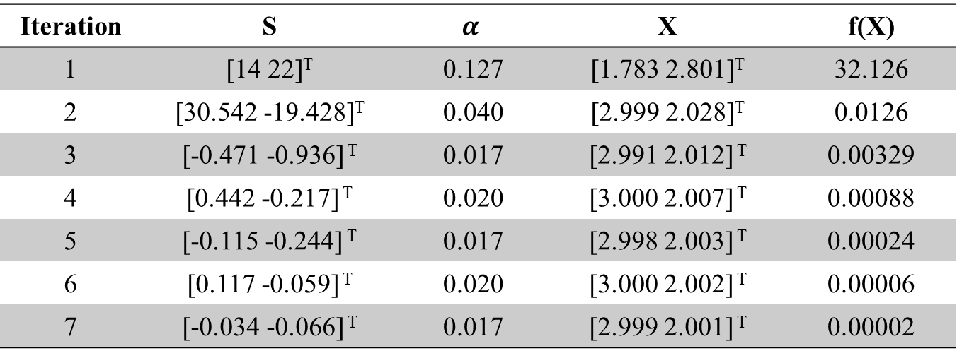
Solution
Iteration | S | $$α$$ | X | f(X)
1 | [14 22]^{T} | 0.127 | [1.783 2.801]^{T} | 32.126
2 | [30.542 -19.428]^{T} | 0.040 | [2.999 2.028]^{T} | 0.0126
3 | [-0.471 -0.936] ^{T} | 0.017 | [2.991 2.012] ^{T} | 0.00329
4 | [0.442 -0.217] ^{T} | 0.020 | [3.000 2.007] ^{T} | 0.00088
5 | [-0.115 -0.244] ^{T} | 0.017 | [2.998 2.003] ^{T} | 0.00024
6 | [0.117 -0.059] ^{T} | 0.020 | [3.000 2.002] ^{T} | 0.00006
7 | [-0.034 -0.066] ^{T} | 0.017 | [2.999 2.001] ^{T} | 0.00002

